Slide 1


Spoke-Darts for High-Dimensional Blue-Noise Sampling
Scott A. Mitchell ACM TOG 37:2, May 2018 Scott A. Mitchell, Mohamed S. Ebeida, Muhammad A. Awad, Chonhyon Park, Anjul Patney, Ahmad A. Rushdi, Laura P. Swiler, Dinesh Manocha (now UMD), Li-Yi Wei
SIGGRAPH 2018 18 minutes talk 15 Aug 10:45 am session talk 4 West Building, Room 109-110
Notes:
Scott Mitchell
title
Thank partners, especially Li-Yi

Slide 2
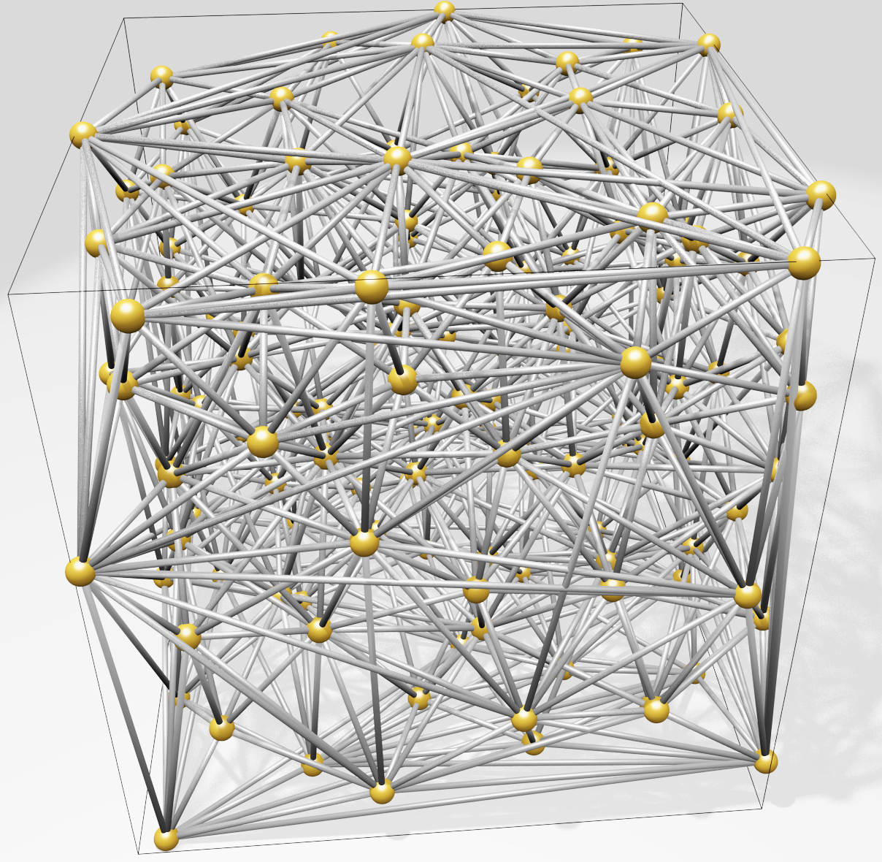
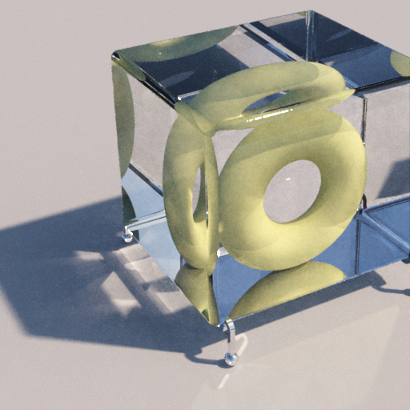
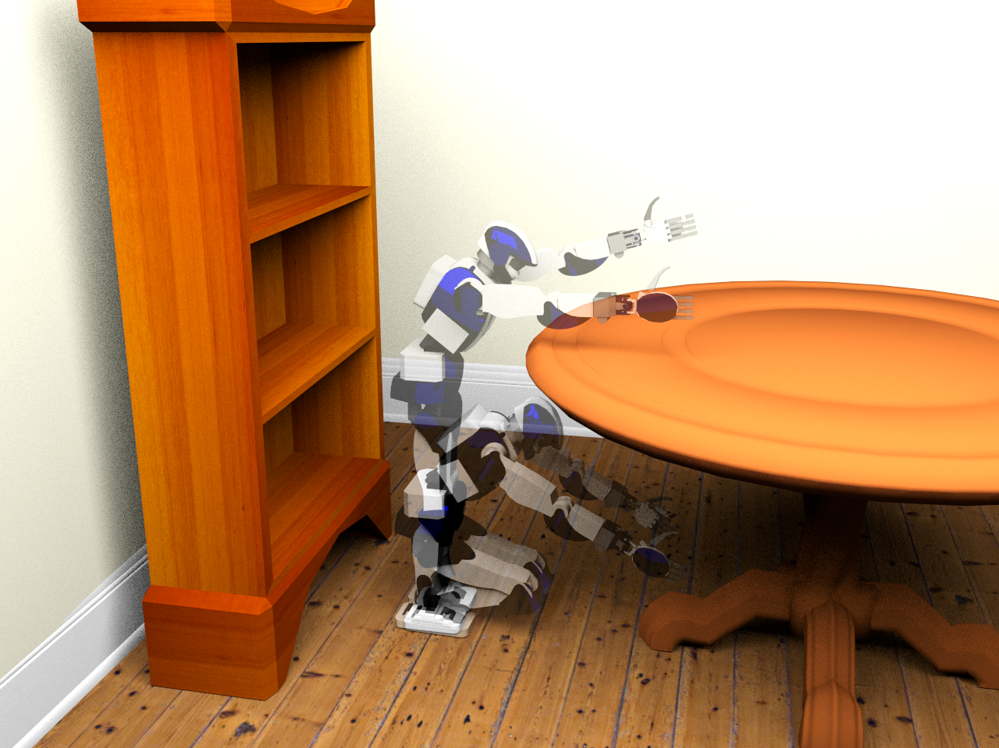
Motivation
High-dimensional blue-noise sampling is useful but hard to generate especially adaptively!
Render
Geometry
8-100D: approximate Delaunay Graphs (Voronoi neighbors)
8D: proof-of-concept path tracing
Social proof of utility: Bridson SIGGRAPH 2007 cited 200 times
23D: find a path in robot configuration space
Motion Plan
Optimize
100D: adaptively explore black-box function to find global minimum
Notes:
why would you want high-d blue noise?
in paper, demo apps ...
evidence or relevance I'm most interested in is attention given to prior solution
clear improvement : discovered flaws, fixed, and provided guarantees

Slide 3
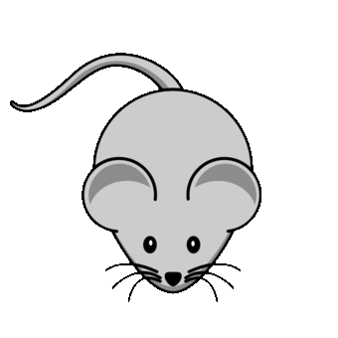

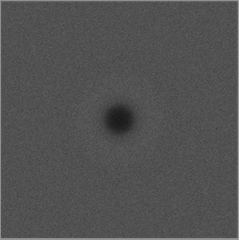
Motivation
Maximum
domain-to-sample distance
Goal: algorithm to produce point distributions
Requirements
Output: blue-noise, uniform-random point distribution except
No points too close
No big gaps
Process
Memory & time scales well to high dimensions (e.g. 20D)
Locally adaptive, general domain shapes
Confidence: provable guarantees on output quality
Goal: algorithm to produce point distributions
Requirements
Output: blue-noise, uniform-random point distribution except
No points too close
No big gaps
Process
Memory & time scales well to high dimensions (e.g. 20D)
Locally adaptive, general domain shapes
Confidence: provable guarantees on output quality
Goal: algorithm to produce point distributions
Requirements
Output: blue-noise, uniform-random point distribution except
No points too close
No big gaps
Process
Memory & time scales well to high dimensions (e.g. 20D)
Locally adaptive, general domain shapes
Confidence: provable guarantees on output quality
Goal: algorithm to produce point distributions
Requirements
Output: blue-noise, uniform-random point distribution except
No points too close
No big gaps
Process
Memory & time scales well to high dimensions (e.g. 20D)
Locally adaptive, general domain shapes
Confidence: provable guarantees on output quality
Minimum sample separation
RP Radial Power
RDF Radial Distance Function

Slide 4
What’s wrong with the algorithms we already have?
SimpleMPS guarantees saturation
runtime & memory
divide domain into cubes, diagonal length r while ∃cubes, and cube diagonal > machine precision do (A(d) × #cubes) times: pick a cube pick candidate sample from cube if distance(candidate, prior samples) > r accept candidate as sample discard cube refine remaining cubes discard covered cubes
darts
refine
darts
refine
SimpleMPS, “A Simple Algorithm for Maximal Poisson-Disk Sampling in High Dimensions,” Eurographics 2012.
Notes:
simple mps
saturation
runtime
describe algorithm
what's not to love?

Slide 5
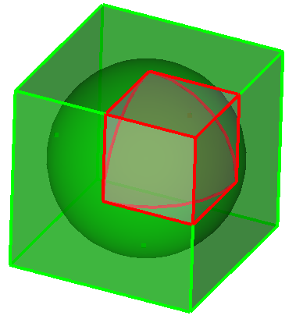
What’s wrong with the algorithms we already have?
SimpleMPS guarantees saturation … but doesn’t scale by dimension, d. ☹
runtime & memory
Problem: cube poorly approximates sphere Exponentially worse as dimension increases More empty boxes, memory limit d≈6
darts
…
refine
d=1
V(cube) = 1
V(sphere) = 1
d=2
V(cube) = 1
V(sphere) = 0.785…
d=3
V(cube) = 1
V(sphere) = 0.523…
d→∞
V(c) = 1
V(s) → 0
darts
Any algorithm that constructs (an approximation of) remaining sample space is doomed to be exponential-in-d
refine
SimpleMPS, “A Simple Algorithm for Maximal Poisson-Disk Sampling in High Dimensions,” Eurographics 2012.
Notes:
doesn't scale with dimension
vanishingly poor time and memory as d increases

Slide 6
What’s wrong with the algorithms we already have?
Bridson 2007* scales
runtime & memory
Front set = one sample do prior_sample = randomly pop Front do pick candidate from (r,2r) annulus around prior_sample if distance(candidate, all samples) > r accept candidate as sample add candidate to Front until 30 consecutive rejections until Front is empty
Bridson 2007 pseudocode, modified for exposition
30+ depending on dimension
*Modified to eliminate a background grid and exponential-in-d complexity.
Bridson 2007, "Fast Poisson disk sampling in arbitrary dimensions." SIGGRAPH '07 sketch.
Notes:
Here's one that scales
<click> to start animation
describe alg while animating

Slide 7
What’s wrong with the algorithms we already have?
Bridson 2007* scales … but doesn’t guarantee saturation ☹
runtime & memory
Trivial bound on empty volume in one annulus.
Unknown if saturated outside all annuli?
?
Bridson 2007, "Fast Poisson disk sampling in arbitrary dimensions." SIGGRAPH '07 sketch.
Notes:
no saturation guarantee

Slide 8
Proposed Spoke-Darts algorithm
Spoke-Darts scales
runtime & memory
Front set = one sample do prior_sample = randomly pop Front do pick candidate from radial line through (r,2r) annulus around prior_sample if distance(candidate, all samples) > r accept candidate as sample add candidate to Front until 12 consecutive rejections until Front is empty
Spoke-Darts change from Bridson in red
12 same for all dimensions
O
Spoke-Darts for High-Dimensional Blue-Noise Sampling, TOG 72:2, SIGGRAPH 2018.
Notes:
Our solution is to replace point samples with line samples
<click> to start animation
anchor point
<click> continue

Slide 9
Proposed Spoke-Darts algorithm
Spoke-Darts scales … and guarantees saturation ☺
runtime & memory
Provable bound on size of a void outside all annuli!
!
Spoke-Darts for High-Dimensional Blue-Noise Sampling, TOG 72:2, SIGGRAPH 2018.
Notes:
what's so great about line samples?
enables proof of saturation

Slide 10
Suppose there is void outside all disks
Proof of saturation
Spoke-Darts scales … and guarantees saturation
One disk
Missed 12 times, so area is probably small, R = area(shared) / area(disk)
i.e. Probability of 12 misses = 𝝥 (1-R)¹² < e^{(-12R)}
All disks Probability all missed = product of probabilities
p = 𝚷 e^{(-12 R_i)} = e^{-12 𝚺 R_i}. So area sum is small.
Small surface area → small void radius
No big gaps!
Notes:
proof sketch
consider void...
<click>
one disk touching void
<click>
all bounding disks - areas add up to still be small
<click>
small surface area -> small radius

Slide 11
Structure of saturation guarantee
Magic values for dimensional independence
e.g.
where
e.g.
chance beta exceeded
#misses, failed candidates
dimension
you get to pick any three
Notes:
explain structure, terms
Beta ratio of distances we talked about, domain pt to sample, sample to sample
m alg param
<click>
eps and m in proper ratio -> dimensional independence
<click>
m=12 works in paper
m=30, would take 3x longer, provide vanishingly small probability of large gaps

Slide 12
Output Saturation in Practice
Output Saturation in Practice,= better than Bridson
Bridson
Beta Spoke-Darts(d) ≈ Bridson(d-1) one dimension of saturation “for free”
Theory: Beta = constant
Practice: Beta varies with d
Increases (but converges for high d?)
Distribution narrows, consistent with theory
Spoke-Darts
Spoke-Darts
dimension = 2
3
4
5
6
Bridson
Notes:
read
<click>
consistently better saturation, about one dimension for free

Slide 13
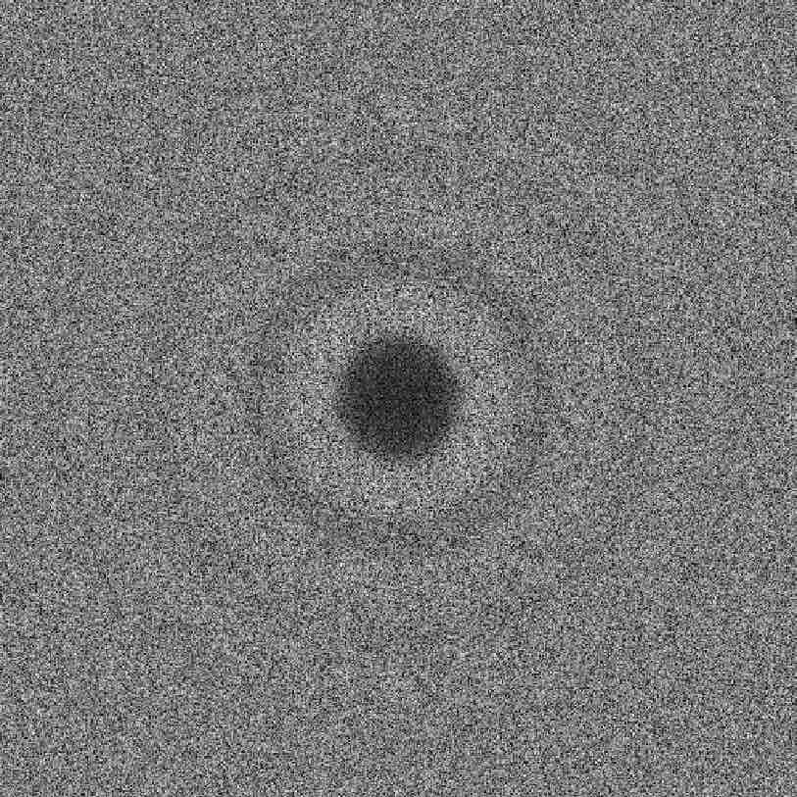
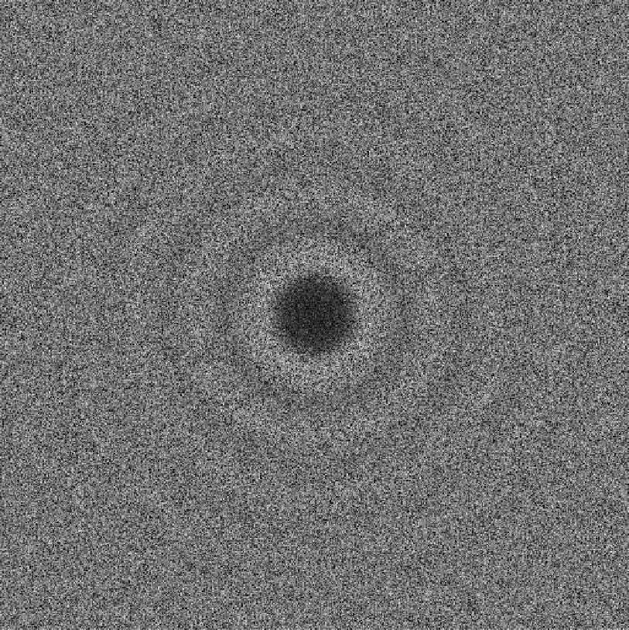
Output Randomness – Blue noise
All these have sharp spike at annuli inner-radius!
d=2
Dart Throwing
Spoke-Darts
Pairwise distances between samples
Bridson 2007
2nd discontinuity annuli outer-radius
RDF distances
Dart throwing images from
Blue Noise Sampling with Controlled Aliasing, TOG 32:3, 2013.
Fourier Transform, 1d integral over angle by radius
Fourier Transform
Notes:
Typical way to evaluate blue noise
rdf - explain
rp
spectrum
<click>
what in the world is this? They all have this spike. many more points are exactly r apart than you would expect from chance
Why would anyone want that?
Appears to be fundamental price for trying to achieve B=1
<click>
top it off, Bridson has a *second* discontinuity
yuck.

Slide 14
Output Randomness – Blue noise
Eliminate the spike
Post-processing optimization* = expensive, 2d
Sample non-uniform by spoke-length? uniform by swept volume?
Made things worse! Any sharp local rule → global discontinuity ☹
Spoke-Darts
RDF distances
Good idea, guaranteed
r_{free} maximum domain-point-to-sample distance
r_{conflict} minimum sample-to-sample distance
Bad idea
r_{free} = r_{conflict} ⟺ 𝜝=1
Traditional goal of Maximal Poisson-disk Sampling!
RP frequency
frequency
* Blue Noise Sampling with Controlled Aliasing, TOG 32:3, 2013.
Notes:
surely we can do better
read
one solution ...
I experimented with
<click>
let me be controversial for a moment
traditional goal is bad

Slide 15
Output Randomness – Blue noise
Eliminate the spike – we solved this in 2012 ☺
† Two-radii sampling : r_{free} ≠ r_{conflict}
Small blue r_{free} minimum sample separation
Large red r_{conflict} maximum domain-to-sample
Unique coverage: accept candidate only if its red disk covers uniquely
Two-spokes mimic Two-radii r_{free} = 2 r_{conflict}
Spoke-Darts
RDF distances
accept, red covers some white
RP frequency
reject, inside a blue disk
reject, red already covered
frequency
† Variable Radii Poisson-Disk Sampling, Canadian Conf. on Comp. Geometry (CCCG) 2012.
Notes:
Actually I already fixed this 6 years ago, about d=5
but let me remind the Graphics Community
<click to appear and disappear each case>
non-unique coverage key difference with prior approaches
<click>
new solution for high-d
<click> each step of first pair of spokes
blue is small rconflict
red is large rfree
spoke from rfree, 2 rfree
temp sample S
*second* spoke +/-2(rfree - rconflict)
<click and just watch animation>

Slide 16
Output Randomness – Blue noise
Eliminate the spike – we solved this in 2012 ☺
† Two-radii sampling : r_{free} ≠ r_{conflict}
Small blue r_{free} minimum sample separation
Large red r_{conflict} maximum domain-to-sample
Unique coverage: accept candidate only if its red disk covers uniquely
Two-spokes mimic Two-radii r_{free} = 2 r_{conflict}
Spoke-Darts
RDF distances
† Variable Radii Poisson-Disk Sampling, CCCG 2012.

Slide 17
Output Randomness – Blue noise
Eliminate the spike – we solved this in 2012 ☺
† Two-radii sampling : r_{free} ≠ r_{conflict}
Small blue r_{free} minimum sample separation
Large red r_{conflict} maximum domain-to-sample
Unique coverage: accept candidate only if its red disk covers uniquely
Two-spokes mimic Two-radii r_{free} = 2 r_{conflict}
Spoke-Darts
RDF distances
† Variable Radii Poisson-Disk Sampling, CCCG 2012.

Slide 18
Output Randomness – Blue noise
Eliminate the spike – we solved this in 2012 ☺
† Two-radii sampling : r_{free} ≠ r_{conflict}
Small blue r_{free} minimum sample separation
Large red r_{conflict} maximum domain-to-sample
Unique coverage: accept candidate only if its red disk covers uniquely
Two-spokes mimic Two-radii r_{free} = 2 r_{conflict}
Spoke-Darts
RDF distances
† Variable Radii Poisson-Disk Sampling, CCCG 2012.

Slide 19
Output Randomness – Blue noise
Eliminate the spike – we solved this in 2012 ☺
† Two-radii sampling : r_{free} ≠ r_{conflict}
Small blue r_{free} minimum sample separation
Large red r_{conflict} maximum domain-to-sample
Unique coverage: accept candidate only if its red disk covers uniquely
Two-spokes mimic Two-radii r_{free} = 2 r_{conflict}
Spoke-Darts
RDF distances
† Variable Radii Poisson-Disk Sampling, CCCG 2012.

Slide 20
Output Randomness – Blue noise
Eliminate the spike – we solved this in 2012 ☺
† Two-radii sampling : r_{free} ≠ r_{conflict}
Small blue r_{free} minimum sample separation
Large red r_{conflict} maximum domain-to-sample
Unique coverage: accept candidate only if its red disk covers uniquely
Two-spokes mimic Two-radii r_{free} = 2 r_{conflict}
Spoke-Darts
RDF distances
† Variable Radii Poisson-Disk Sampling, CCCG 2012.

Slide 21
Output Randomness – Blue noise
Eliminate the spike – we solved this in 2012 ☺
† Two-radii sampling : r_{free} ≠ r_{conflict}
Small blue r_{free} minimum sample separation
Large red r_{conflict} maximum domain-to-sample
Unique coverage: accept candidate only if its red disk covers uniquely
Two-spokes mimic Two-radii r_{free} = 2 r_{conflict}
Spoke-Darts
RDF distances
† Variable Radii Poisson-Disk Sampling, CCCG 2012.
Notes:
what we get is

Slide 22
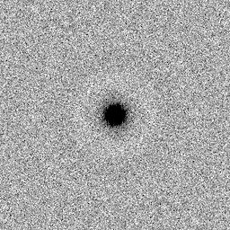
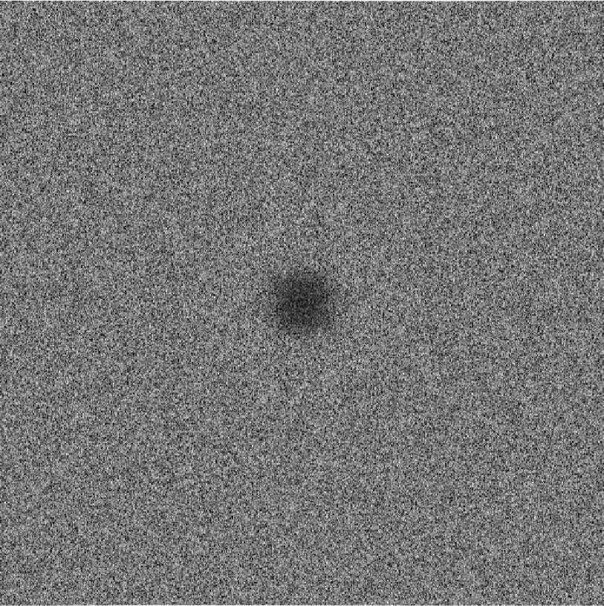
Output Randomness – Blue noise
Flat spectrum no spikes
d=2
Two-Radii
Two-Spokes
Spoke-Darts
Eliminate spike: solved 2012 for low-d
Eliminate spike: solved 2018 for high-d
RDF distances
Pairwise distances between samples
RDF distances
Fourier Transform, 1d integral over angle by radius
RP frequency
RP frequency
Fourier Transform
frequency
frequency
Notes:
no more spike
no more oscillations
very faint light ring around dark center
two-spokes doubles the beta by the 2x rfree

Slide 23
Runtime , best one can hope for
d
Linear scaling is perfect: primitives are O(d)
n²
Finding neighbors in high dimensions expensive
Each of n samples, find neighbors
Each of n may have n neighbors
Finding them quickly still won’t prevent n²
Spoke-Darts ≈ Bridson 2007 due to simple primitives
Is point in sphere
Trim segment by sphere
Runtime( Two-Spokes ) > Runtime( One-Spoke )
mostly due to 2 × radius of annulus, many more neighbor disks
Notes:
d perfect
n^2 : find if you can do neighbor finding better than brute force in d=20 ... result!
but in high-d all the points are neighbors so n^2 best you can hope for
fast - simple primitives
two-spokes expensive from large search radius

Slide 24
Application Delaunay Graph
Trim line-spokes to find “significant” neighbors in Voronoi diagram
New graph edge to
significant neighbor
3d rendering of 8d graph

Slide 25
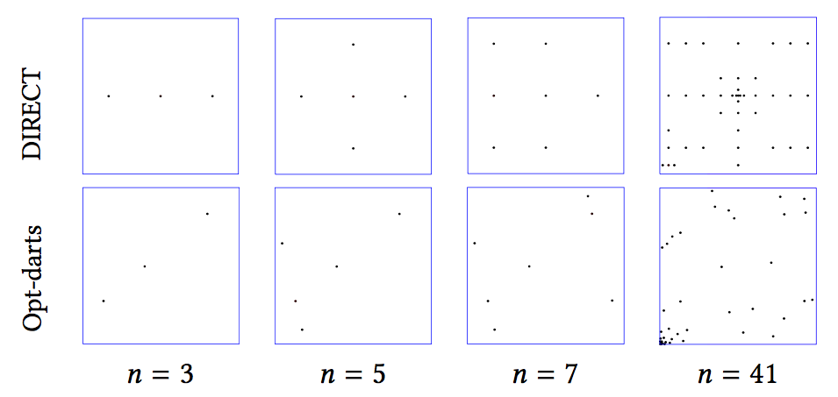
Application Global Optimization
DIRECT = DIviding RECTangles
Divide space by rectangles
Evaluate sample point at center of rectangle
Subdivide large rectangles with small values
Opt-Darts
Divide space by Voronoi cells (implicit)
Evaluate sample point at center of cell
Subdivide large cells with small values
Delaunay graph decides “large” cells
Spoke-darts selects how to subdivide
Opt-Darts 5-25× speedup over DIRECT
Increasing speedup with d
Rectangle increasingly bad approximation of Voronoi cell
More-random sample patterns

Slide 26
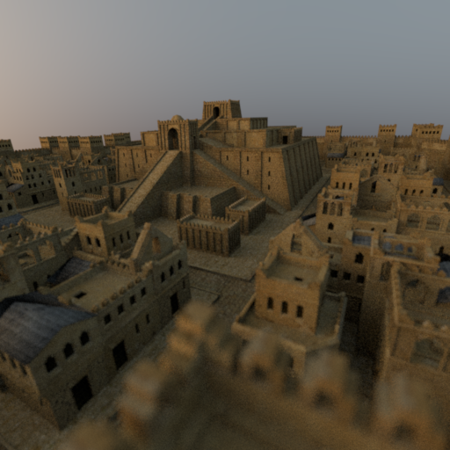

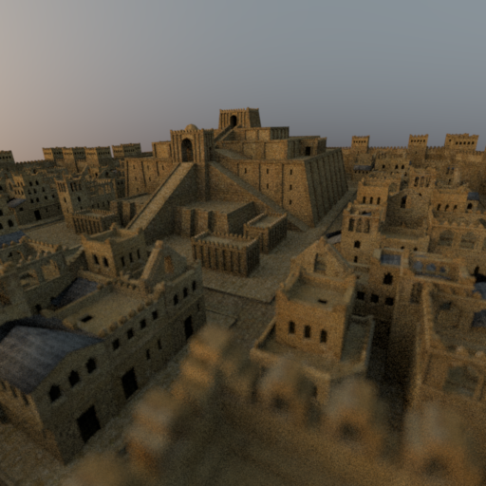
Application Rendering
Mitsuba ray tracing
4D = 2 screen × 2 lens
16 samples per pixel
Spoke-darts comparable to alternatives
Stratified
Low discrepancy

Slide 27
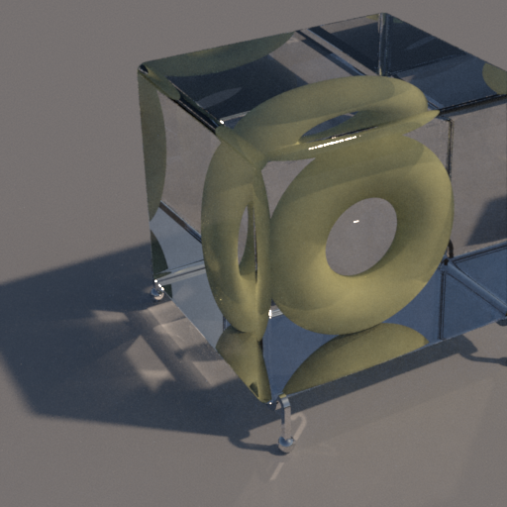
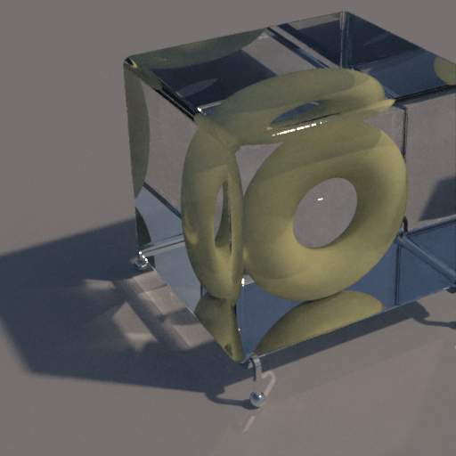

Application Rendering
Mitsuba ray tracing
8D = 2 sky-emitter × 2 screen × 2 × 2 bounce
256 samples per pixel
Spoke-darts comparable to alternatives
Stratified
Low discrepancy

Slide 28
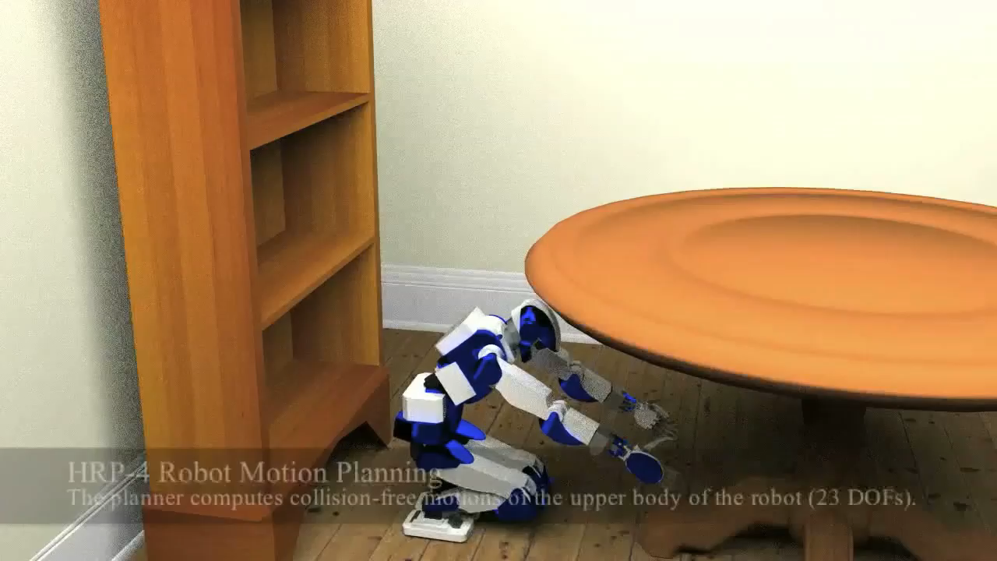
Application Motion Planning
Path = robot: under table to up book: table to shelf
23d = degree of freedom robot
Non-uniform: joint angles and room dimensions
Pre-sample configuration space with spoke-darts
Enable exploration of multiple paths in parallel avoiding redundant searches
Order of magnitude speedup

Slide 29
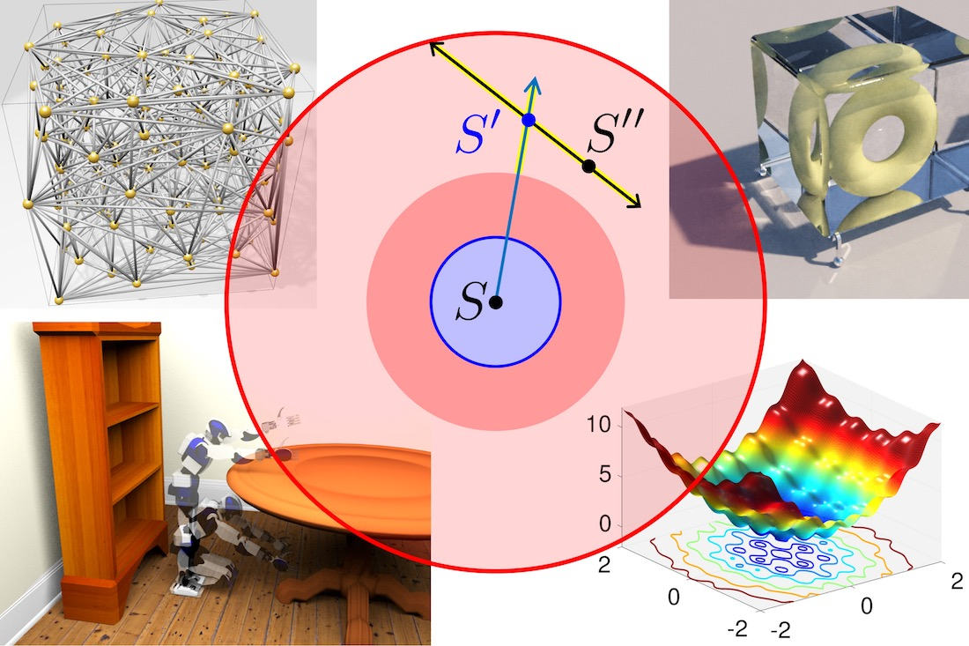
Conclusions
Spoke-Darts Blue-noise Linear scaling by dimension
Free software
SpokeDartsPublic on github https://github.com/samitch/SpokeDartsPublic
Want high-d blue noise?
Spoke-darts line sampling
Guaranteed saturation
Adaptive sampling over general domains
Nearly as easy to implement as Bridson 2007 (especially since I already did that for you :) comparable speed
Want better spectrum?
Two-spokes
Practical to 30d, depending on domain periodicity, application
Open problems
Prove non-trivial saturation-bound on Bridson 2007?
Does saturation matter for high-d rendering, etc.?
Two-Spokes
Eliminate spike: solved 2018 for high-d
Geometry
Render
Motion Plan
Optimize
Notes:
I've made the software available
Guidance
(read)
Open problems
questions?

Slide 30
Backup slides
Spoke-Darts

Slide 31
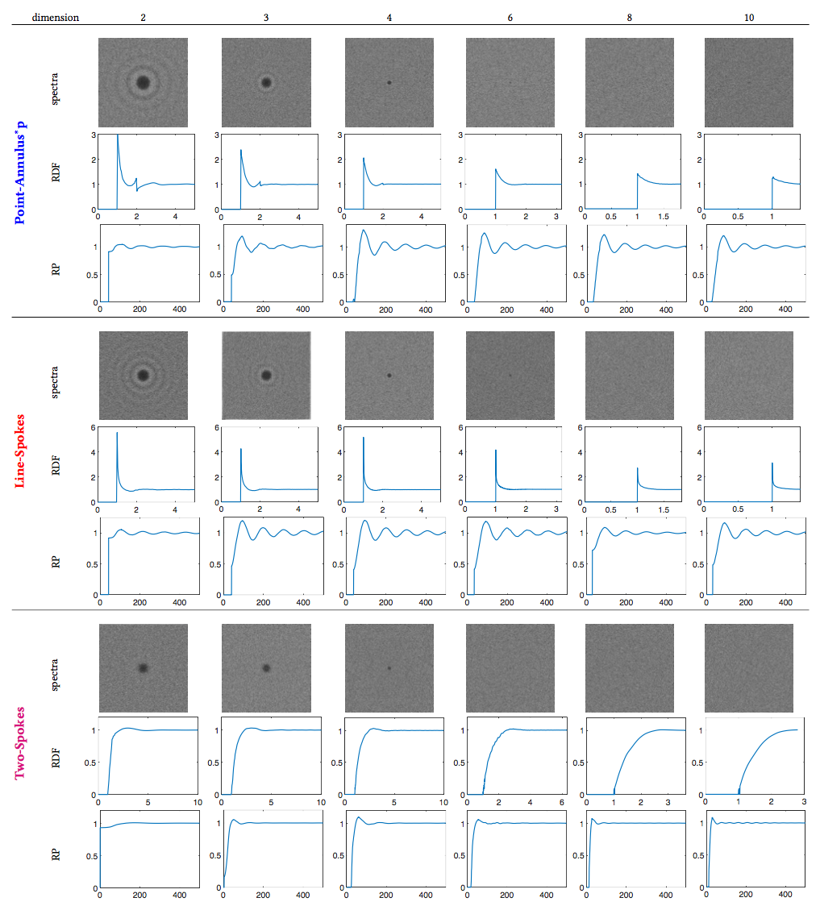
Spectra by dimension

